Slide 1
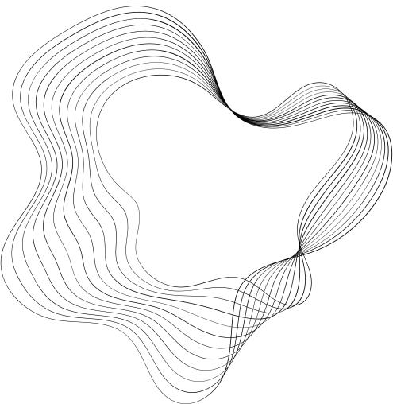
HANDWRITTEN DIGIT RECGNITION USING GAN
NAAN MUTHALAVAN PROJECT
PRESENTED BY: VIMALESH M P (71772118L11)
INFORMATION TECHNOLOGY
GOVERNMENTCOLLEGEOF TECHNOLOGY
COIMBATORE,

Slide 2
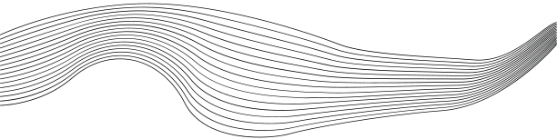
OUTLINE
01
PROBLEM STATEMENT
02
PROPOSED SYSTEM/SOLUTION
03
SYSTEM DEVELOPMENT APPROACH
04
ALGORITHM & DEPLOYMENT
05
CONCLUCION

Slide 3
PROBLEM STATEMENT
Here's a concise problem statement for the project involving the use of a Generative Adversarial Network (GAN) to generate images of handwritten digits.
Problem Statement
Develop a Generative Adversarial Network (GAN) to generate realistic images of handwritten digits to augment existing datasets, thereby enhancing the training process and performance of models for digit recognition tasks.

Slide 4
Proposed Solution
1. Develop a Generative Adversarial Network (GAN)
Generator: Creates new images that mimic handwritten digits from a random noise input using neural networks.
Discriminator: Acts as a classifier to differentiate between real images from the MNIST dataset and fake images produced by the generator.
2. Training Process:
Adversarial Training: The generator and discriminator are trained together, where the generator learns to make more realistic images to fool the discriminator, and the discriminator learns to better identify fake image.
PROPOSED SOLUTION

Slide 5
Proposed Solution
3. Data Augmentation with Generated Images:
After training, use the generator to create new digit images that are added to the original MNIST dataset to enhance its diversity and volume.
4. Integration and Testing:
Use the augmented dataset to train a digit recognition model and assess its performance, especially on test data.
5. Quality Control and Evaluation:
Qualitative Assessments
Quantitative Metrics
PROPOSED SOLUTION

Slide 6
System Approach
Hardware Requirements:
Processor: A modern multi-core processor (e.g., Intel i7 or AMD Ryzen 7) to handle complex computations efficiently.
Graphics Processing Unit (GPU): A high-performance GPU with CUDA support (e.g., NVIDIA GTX 1080 or higher) .
RAM: Minimum of 16 GB RAM, but 32 GB or more is recommended for handling large datasets and simultaneous processing tasks.
Storage: At least 1 TB of storage space to accommodate large datasets, training models, logs, and system backups.
PROPOSED SOLUTION

Slide 7
Algorithm & Deployment
1.Generative Adversarial Network (GAN) Setup:
Generator: The generator network starts with a random noise vector and uses a sequence of transposed convolutional layers (or fully connected layers for simplicity) to produce a 28x28 pixel image that resembles handwritten digits.
Discriminator: The discriminator network takes an image as input (either a real image from the dataset or a fake image from the generator) and uses convolutional layers (or fully connected layers) to output a probability indicating whether the image is real or generated.
PROPOSED SOLUTION

Slide 8
Algorithm & Deployment
1.Training Process:
Simultaneous Training: The generator and discriminator are trained simultaneously.
Loss Functions: The discriminator uses binary cross-entropy loss to improve its accuracy in classification.
2.Evaluation and Adjustment:
Image Quality Check: Generate images to visually assess their quality and adjust model parameters or if necessary.
Metrics: Distance to quantitatively evaluate the realism and diversity of generated images.
System Approach
System Requirements:
Operating System: A 64-bit operating system such as Windows 10, Ubuntu 18.04 or later, or macOS Catalina or later.
Development Environment: Python 3.8 or later, with an integrated development environment (IDE) such as PyCharm, Jupyter Notebook, or Visual Studio Code.
Libraries and Frameworks:
TensorFlow 2.x: For building and training the GAN models using Keras API.
NumPy: For high-performance scientific computing and data manipulation.
Matplotlib: For plotting and visualizing images and training metrics.
Pandas (optional): For data manipulation and analysis, if necessary.
PROPOSED SOLUTION

Slide 9
Conclusion
In conclusion, the project to develop a Generative Adversarial Network (GAN) for generating images of handwritten digits showcases the practical application of advanced AI technology to enhance machine learning models. By successfully training a GAN to produce realistic digit images, this system provides a valuable tool for augmenting datasets, thereby improving the accuracy and robustness of digit recognition technologies.l): For data manipulation and analysis, if necessary.
PROPOSED SOLUTION

